Slide 1
USER’S GUIDE FOR MAKING PRESENTATIONS
General information
There are different kinds of slides you can use to create your presentation. Below is a
description about the different kinds of slides and how you can use them in your
presentation.
Title slide
Four title slides are provided. Each title slide has a different background to choose from. See instructions on the next slide 3 to add these slides to your presentation.
Chapter slide
Five chapter slides are provided with different graphic forms per slide. See instructions on the next slide 3 to add these slides to your presentation.
Regular slide
No graphics are provided on the regular slide. The regular slide can be used for text, with of without bullets. Special slides are available to add graphs and/or pictures to your presentation. See instructions on slide 3.

Slide 2
USER’S GUIDE FOR MAKING PRESENTATIONS
Use of colours
Footer
To insert or change a footer select the ribbon ‘Insert’. Choose in the section ‘Text’ the button ‘Header and footer’. Enter the title of your presentation. The date is automatically set to the date of today . To remove automatic update, select ‘Fixed’ and enter a new date (dd/mm/yyyy). After all fields have been correctly entered, select ‘Set all’.
Use of colours
The following colour scheme has been set. The RGB values are:
These colour values should be used when adding graphs from Excel or other systems
R 52 G 178 B 51
R 207 G 0 B 114
R 254 G 209 B 0
R 0 G 152 B 195
R 220 G 12 B 48
R 0 G 106 B 77
R 79 G 45 B 127
R 136 G 123 B 27
R 0 G 44 B 95
R 97 G 82 B 88

Slide 3
USER’S GUIDE FOR MAKING PRESENTATIONS
Instruction slides layout
Insert new slide
Select ‘New slide’ (Start-ribbon, part ‘Slides’) and choose the desired layout.
Change the layout of a slide
Select ‘Layout’ (Start-ribbon, part ‘Slides’) and choose the desired layout.
Attention!
Remove the instruction slides from your presentation.

Slide 4
BSR project in Twente
Jaco, Marieke, Marielle
Arnd, Vincent, X

Slide 5
overview
Recall tracks:
Discovery Track
Conformance Checking
Prediction
Recommendation
Big infrastructure
PhD4: Monitoring Concurrent Software
(part of Tracks T1 and T2) Huisman & Lagendijk
PhD6: Parallel Checking and Prediction
(part of Tracks T2 and T3) Van de Pol & Van der Aalst

Slide 6
Phd 4: Monitoring concurrent software
Monitoring is a means to check conformance of running software (T2)
Monitoring generates a stream of events for discovery (T1)
Challenges:
Concurrent software: data races under specific schedules
Make monitoring transparent, should not affect program behaviour
Based on local and global annotations
Assertions, permissions, temporal properties

Slide 7
Status
Position has been offered to a promising candidate
Three MSc/BSc projects around this theme:
MSc Interference-free Checking of Assertions (Kandziora, FTfJP’15)
MSc Run-time checking of Permissions (Stijn Gijsen)
BSc Force the Scheduler with CalFuzzer (just started)

Slide 8
Interference-free checking of assertions
FTfJP 2015, Master thesis Jorne Kandziora
Evaluate assertions over snapshot state, so other threads cannot interfere with their validity
Prototype: Extension of OpenJML, using Strobe framework
Strobe originally used for asynchronous checking of assertions, to minimise performance impact

Slide 9
Run-time checking of permissions
Master thesis Stijn Gijsen
Permission annotations (read, write access to a location) guarantee absence of data races
Threads should only access data when they have a permission
Prototype: extension of VerCors tool set (for static verification of concurrent software)

Slide 10
Plans
Just started BSc project: techniques to force scheduler to investigate different executions (investigate CalFuzzer)
Some ideas:
Can run-time checking and annotations be used to provide structure in the log?
Can local run-time checks or monitors be combined to provide global guarantees?

Slide 11
PhD6: Parallel Checking and Prediction
Input: process models (for components) discovered in (T1)
Goal: predict future behaviour (T3) as a basis for recommendation (T4)
Idea: future behaviour emerges from composition of learnt components
Other ideas: unspecified inputs, fuzzing,
Ingredients:
High-performance model checking
Extension to quantitative models and analysis (time, probabilities, …)
Scalable, run on BSR.cloud (Track 5)

Slide 12
Status
PhD has started: Vincent Bloemen
multi-core SCC decomposition (basis for model checking)
Postdoc is starting: Arnd Hartmanns (Saarbrücken)
Expert in quantitative modeling languages and analysis tools
Related work:
LTSmin high-performance model checker (recently also Petri nets)
Sylvan: scalable multi-core BDD package (recently also MTBDDS)

Slide 13
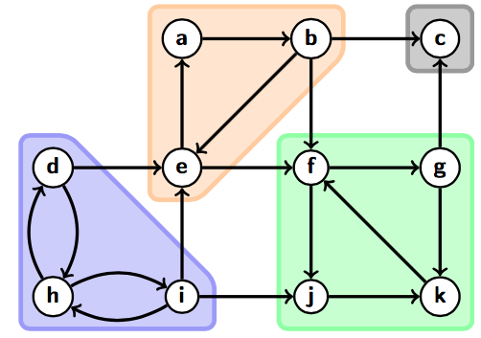
Multi-core On-the-fly SCC decomposition
Parallel implementation of DFS (!)
Independent workers traverse the graph
Partial SCCs are shared through a concurrent Union-Find datastructure
Worst-case quasi-linear time
Experiments show 10-30x speedup w.r.t. Tarjan on 64 core-machine
Paper submitted to PPoPP, now in contact with Robert E. Tarjan

Slide 14
Possible directions
Extend to games (and-or-trees)
Useful for test generation
Model-based testing: an active “run-time” technique (M. Stoelinga)
Extend to quantitative model checking
End-components instead of SCCs
Parallelisation of process mining / learning algorithms? L*?
Correctness proofs
Invariant generation of DFS-based algorithms, theorem provers
Algorithms could provide input for monitoring (T2) and Visualisation

Slide 15
Testing @ utwente in two slides
Mariëlle Stoelinga
Formal Methods & Tools
University of Twente

Slide 16
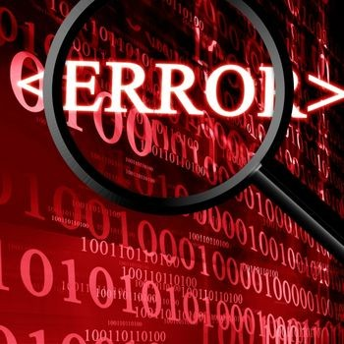
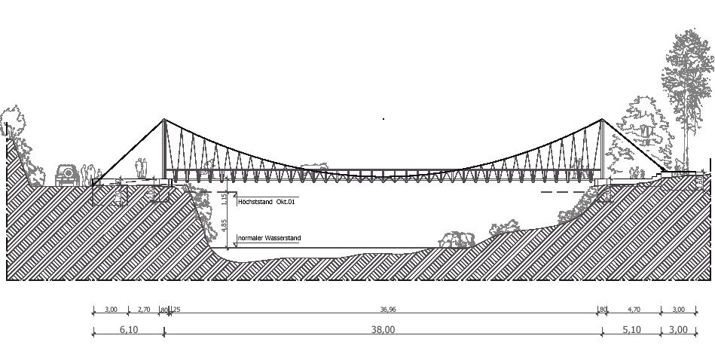
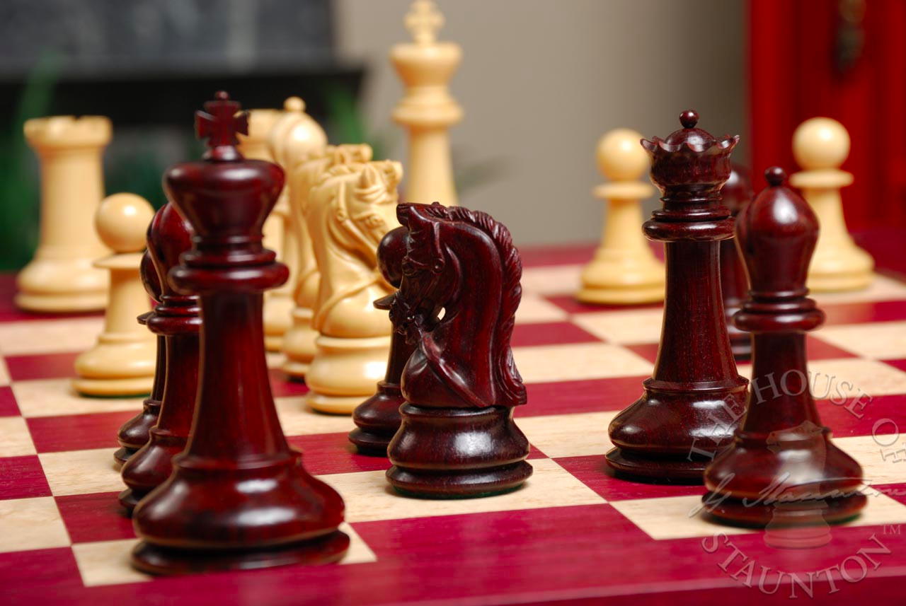
BEAT: better testing with game theory (NWO-top)
Test optimization
Testing = optimization problem
max impact, min cost
Better steering of test process
towards system risks, coverage, …
Testing as a game
2-player game: SUT vs tester
Game strategy = test case
Attributes
Time, probability, hybrid…
Overarching theory for MBT test generation

Slide 17
SUMBAT: supersizing model-based testing (STW-OTP)
Model-based testing & test-based modeling
Learn models from system logs (automaton learning)
Active learning
Learn Delta’s / differences
Statistical user profiles
Test common behavior more thoroughly
Probability / statistics
Partners
ASML, OCE, PANanalytical, TNO-ESI
Nijmegen: Vaandrager / Tretmans

Slide 18
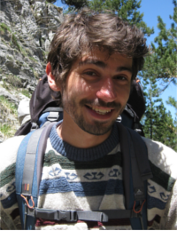
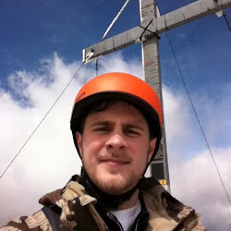
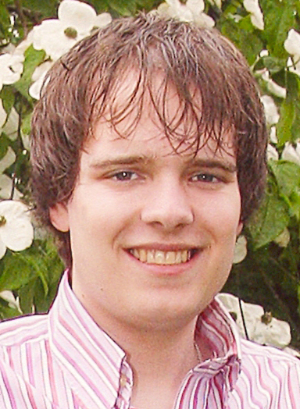
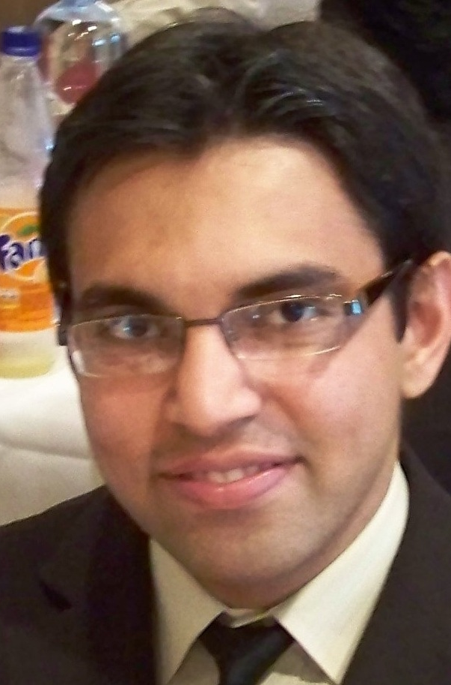
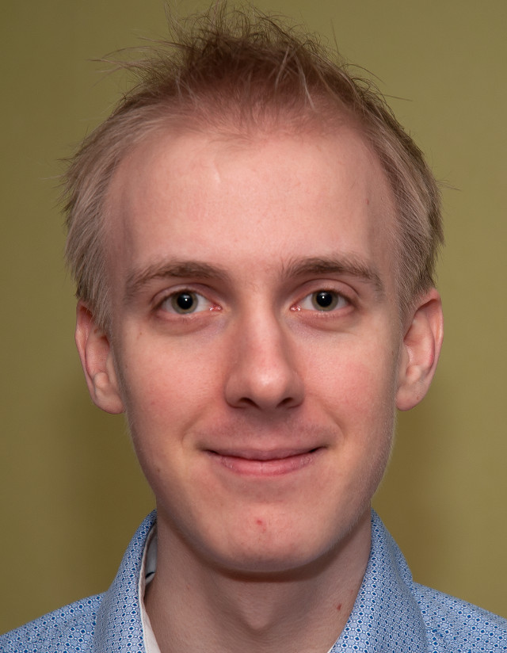
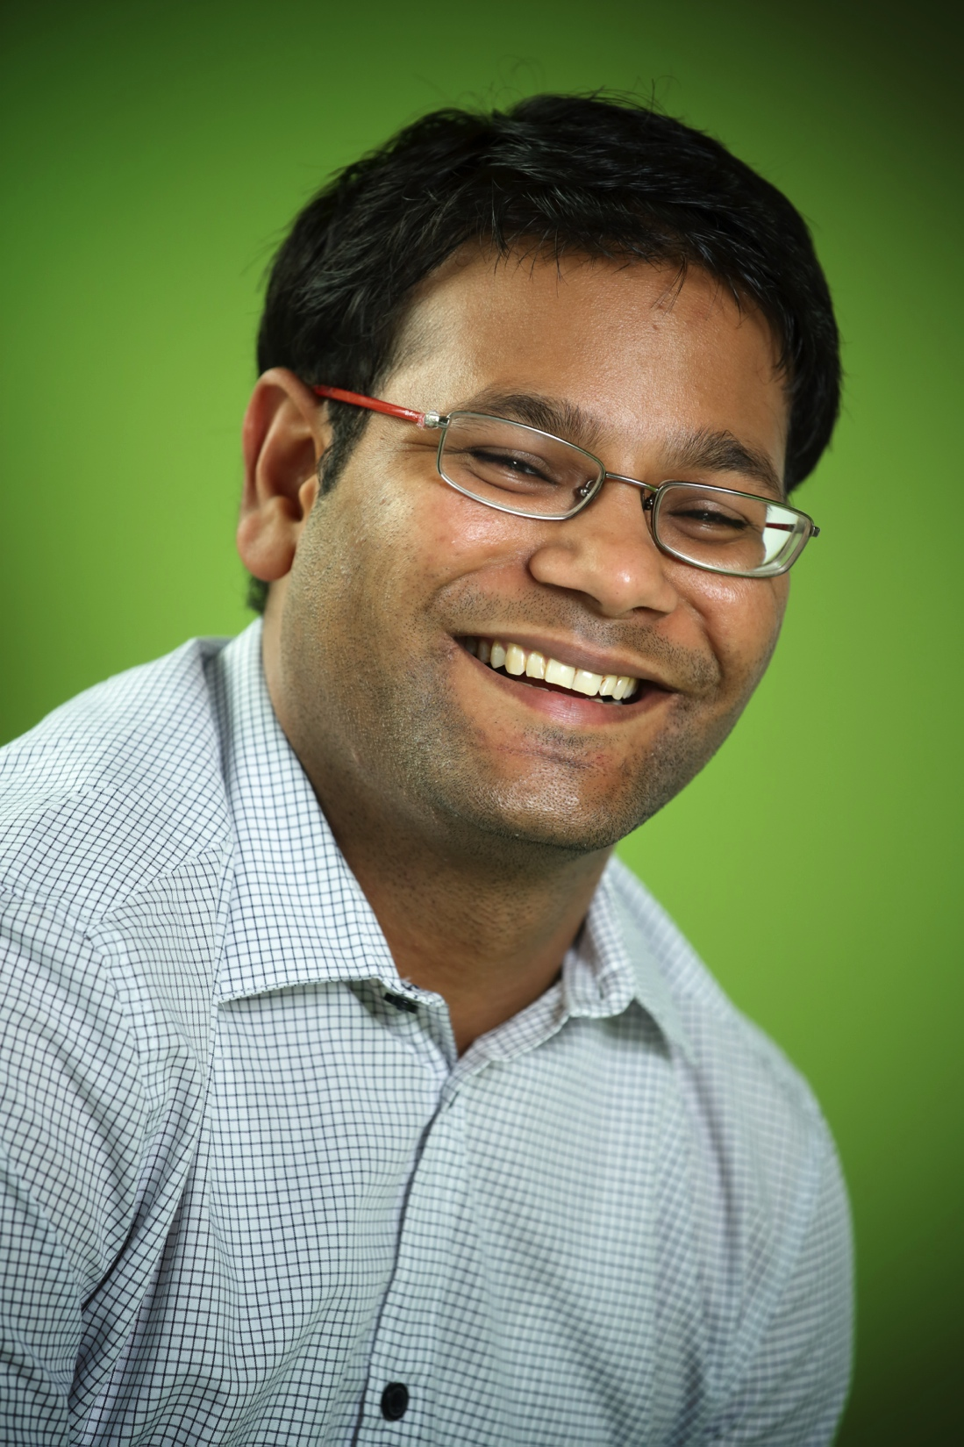
Marcus Gerhold
Dennis Guck
Jeroen Meijer
Waheed Ahmad
Enno Ruijters
Rajesh Kumar
UNIVERSITY OF TWENTE.
UNIVERSITY OF TWENTE.
UNIVERSITY OF TWENTE.

